Slide 1
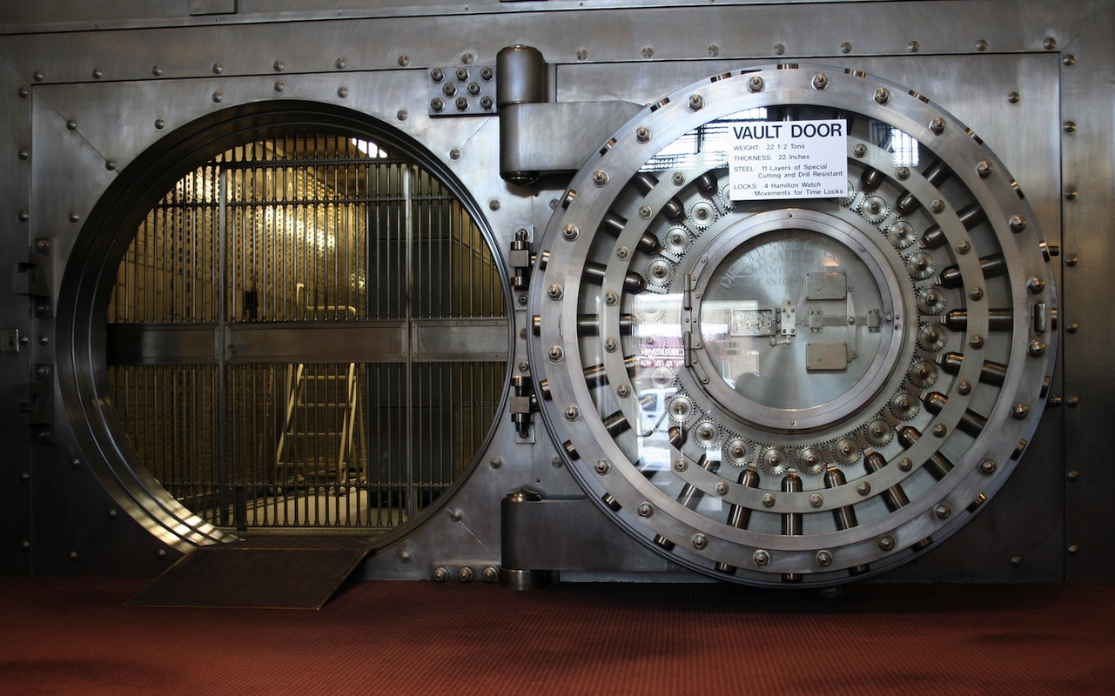
OCEAN’S 15
Bank heist adventure game by team 15

Slide 2

The Story
The character played by the user is an ordinary man, with honest motives but questionable morals, that has agreed to take part in a bank heist.
The realistic backstory and description of the main character plays a large part in this game, giving each move and decision a purpose.
An element of the game worth noting is the ‘pre-game’ phase, in which the user can make a series of decisions and purchases that can either benefit or work against them once the main game begins.
Your goal is to make a series of decisions that will affect your outcome, and manoeuvre through the bank towards the vault, in which you’ll find the riches you desire.
There are many options available to the user, giving a large amount of content for the user to explore and thus entertain them for extended periods of time
Using a mixture of items the player has purchased during the pre-planning phase, minor decisions made throughout, and various items found scattered throughout the bank, the character must find a way to complete the tasks and final goal efficiently.
Interesting rules that measure the character’s level of suspicion and morality will effect the outcome of the game. This creates a dynamic storyline as there are many different paths that the user can follow and thus various endings.

Slide 3

Defining Features
While text-based games all follow a similar format, this game has some defining features that make it stand out:
Limited Turns: The tasks and final goal (stealing the money), must all be completed within a set number of turns. Failure to complete everything within this limit will result in a failed attempt.
Scaled Victory: Assuming that you have completed the main objective within the set number of turns, the amount of money that you are able to take is based upon how many turns you have remaining. The less turns needed to finish the game = more money, and a higher score!
A rich back story, with a wide variety of interactive options that will influence the final outcome of the game, including a pre-planning phase that allows you to purchase useful items.
Measure of morality: depending on how ethically the user achieves their goal, various different situations will be triggered, mainly related to the backstory of the character. For example, if the user decides to assault the security guard, this may be the tipping point of a negative outcome in contrast to if the user simply distracted the security guard.
Measure of suspicious activity: The amount of suspicious acts the character performs will be closely related to the user’s ability to reach their goal. i.e. after exceeding a certain threshold, the user will be caught and sent back to a previous checkpoint.
Side-tasks: A series of small-scale tasks that the user must perform in order to gain access to the vault and finish the game
Non-linear story line: many different factors can contribute to the ending that is provided to the user. This ensures that they remain entertained after playing the game multiple times, and adds a dynamic and unique depth that the game would not otherwise have.
Leader board: the user’s score (depending on how efficiently they achieved their goal) will be displayed and compared to other user’s scores.

Slide 4
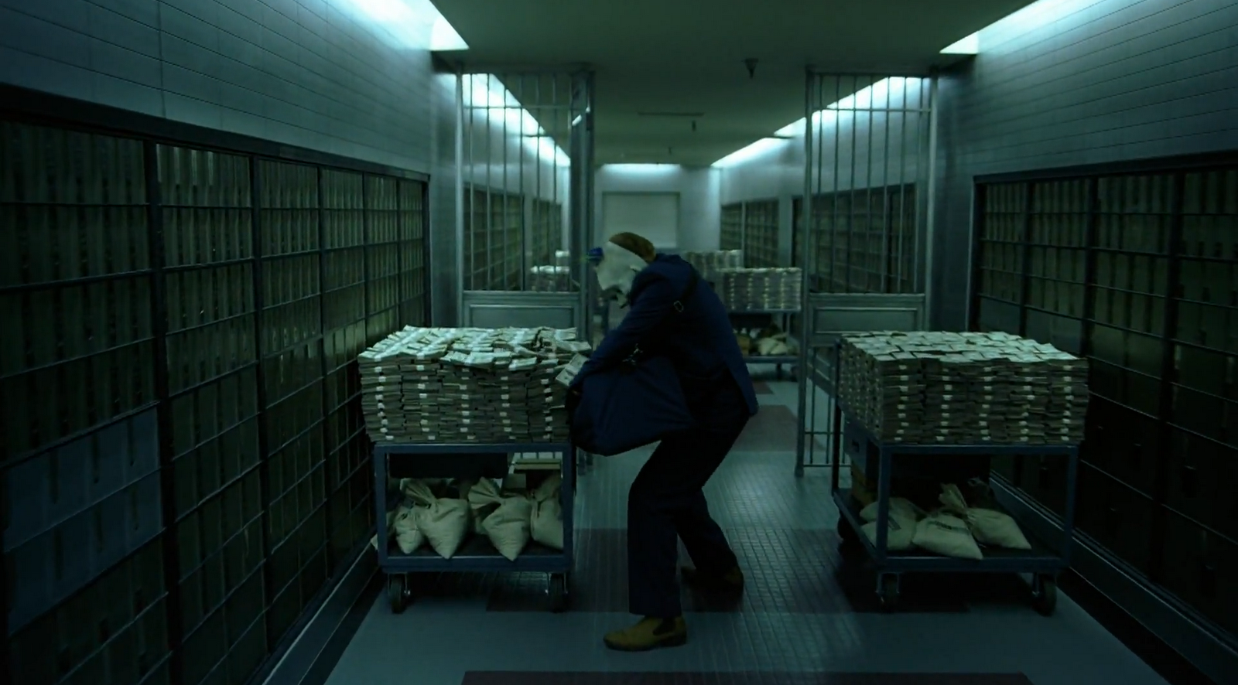
Game Mechanics
It is a classic text-based adventure game, programmed using Python.
The basic commands, and clarity of objectives, makes this game suitable for players of all abilities.
Two main stages to the game: the “pre-planning”, and the “main body.” The reason for this is to create a sense of realism, and it will hopefully engage the player, as they are not simply handed the tools required for an easy victory. The limit on items you are able to choose and carry adds a sense of strategy to the game, rather than mindless movement around a map.
Attributes
A leader board that will be ranked according to how much money you are able to steal from the bank. This means that the game can be played through multiple times, so that you can try to beat your personal best.

Slide 5
Justification of design decisions

Slide 6

Why should you choose this game?
If you are looking for a game with an exciting story, with the freedom to affect the outcome depending on your personal decisions, then this is the game for you!
Ocean’s 15 takes the stereotypical text-based adventure game format, but spices it up with the use of a modern, and somewhat realistic setting, alongside characters you can empathise with, and situations that you trigger by your own actions
Do you think you could carry out a successful bank heist? The only way to find out is to try this game!

